Slide 1

Title of the project : Smart Shopping Cart with Automatic Billing
Name of the Students : Rishika Bajaj - 1602-21-735-165
G.Sai Praneeth -1602-21-735-169
V.Sandeep - 1602-21-735-175
R.Vandana - 1602-21-735-187
Year & Section : 2nd, ECE-C
Batch Number : 14

Slide 2
ABSTRACT
The modern technology has increased the standard of living for the humans. This resulted in large crowds at shopping malls. To handle the large crowd, we must reduce the process of the billing time. This is done using smart shopping system based on RFID. Items that are put in a smart shopping cart are read one by one and the bill is generated and displayed. After the final bill is generated the customer pays the bill by using their Pre charged cards provided by the shopping mall. The aim is to reduce the time consumption needed for the billing system

Slide 3
INTRODUCTION
Project objective: In the present-day shopping system one of the difficulties is to follow queue through the billing process which is time consuming. Hence this project aims to reduce the average time spent by the customer at the shopping mall by implementing automatic billing system using Rfid technology.
Project outline: The main aim of the project is to satisfy the customer and to reduce the time spent on the billing process which is to complete the billing process in the trolley rather than waiting in a queue even for one or two products. The customers must add the products after a short scan in trolley and when the shopping is done the finalized amount will be displayed in the trolley. Customer could either pay their bill by their pre-recharged customer card provided by the shop. Finally, the whole information will be sent to central Pc of the shopping mall

Slide 4
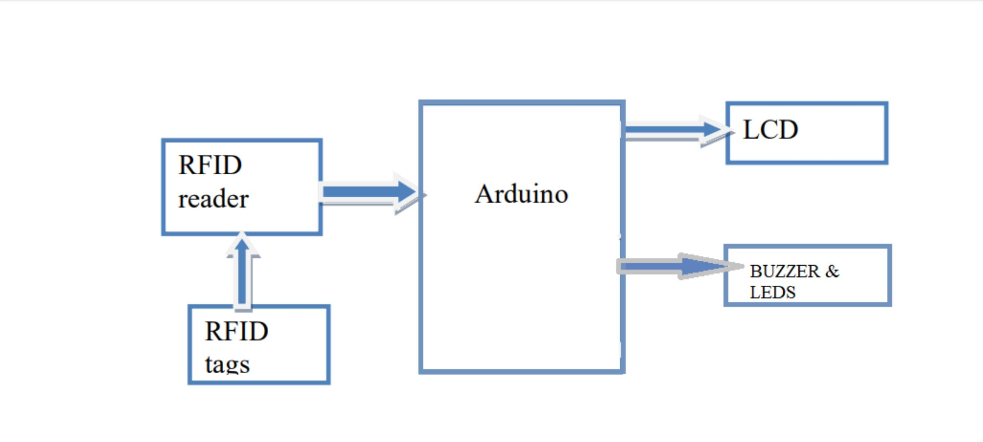
BLOCK DIAGRAM

Slide 5
METHODOLOGY
The methodology of smart shopping cart involves several steps first customers scan the rfid tag on the product label using their smartphones.The rfid tag contains information about the product including its name and price.
Next the rfid scanner in the shopping cart reads the information sends it to the microcontroller.The microcontroller processes the information and displays the product information on the screen.Customers can add the product to their cart and continue shopping.when they are done they can make payments using their smartphones.
At the entrance of the shopping mall, there is a qr code which has information about the map of the shop.This can help customers find products easily.

Slide 6
OPERATION
As shown in the above block diagram, the Arduino is interfaced with all the remaining components. Once the microcontroller is powered up with the using the external power it is initialized and set to the basic settings, now the system is ready to proceed which means the RFID card and the tag can be scanned. Then the RFID card or tag is scanned the RFID reader fetches all the details from the scanned card or tag, and if the scanning process is successful the product details will be transferred to the microcontrollers memory and then will be transferred to the LCD module to be displayed on the LCD screen. Here the RFID module uses the SPI communication technique to transfer or to retrieve the data from the RFID card or tag. After the shopping is completed the entire bill details will be displayed on the LCD screen, each card or tag acts as a product, where the product details are pre early set or dumped into the card.

Slide 7
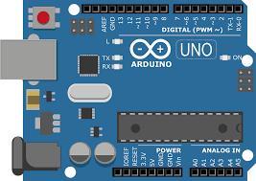
WORKING PRINCIPLE OF COMPONETS
ARDUINO UNO R3:
The Arduino Uno R3 is a versatile device that can be powered on using a USB connection or external power supply. It features a pre-installed bootloader program, which initializes the microcontroller, sets up configuration, and waits for a new program to be uploaded. Programming is done using the Arduino IDE, which is based on C and C++, allowing for easy interaction with sensors, actuators, and other components. The Arduino Uno R3 can be uploaded using a USB connection, and the Arduino IDE communicates with the board via the USB port. The microcontroller's flash memory stores the program instructions, and the CPU reads them sequentially to perform necessary operations. The Arduino Uno R3 supports serial communication and can interact with its environment, allowing for sense and response to inputs, calculations, decisions, and control of actuators. The program runs in an iterative process, allowing for continuous monitoring, response to changes, and updating outputs.

Slide 8
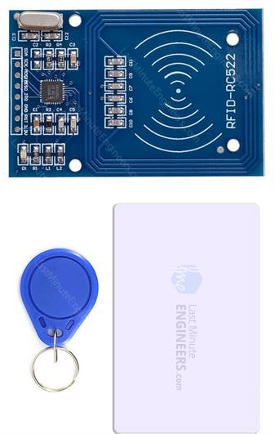
MFRC 522:
The MFRC522 module is a wireless communication system that uses an integrated antenna to transmit and receive radio frequency signals, enabling communication with RFID tags or cards. It operates at 13.56 MHz, a standard frequency for RFID systems. The module is initialized, detects RFID tags or cards, and supports various communication protocols, including ISO/IEC 14443A, for contactless smart cards. It can exchange data with the tag or card, perform authentication, and implement error detection and correction mechanisms. The received data can be processed by a microcontroller or other devices, enabling applications such as access control, identification, tracking, and authentication.

Slide 9
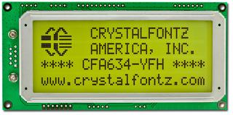
LCD DISPLAY (20X4):
The LCD display requires a power supply, typically 5V or 3.3V, to operate. Initialization involves sending specific commands to the controller chip, setting up the display's operating mode and preparing it for data and command reception. The LCD display communicates with the microcontroller using a parallel interface, sending data and command signals through multiple data pins. Control signals such as Register Select (RS), Read/Write (R/W), and Enable (EN) are used to latch data or command provided on the data pins. The microcontroller sends appropriate commands and data sequences to display characters or strings on the LCD.
Custom characters can be created using predefined patterns stored in the character generator RAM (CGRAM). Backlight control is possible using a backlight pin connected to the microcontroller. Refresh rate is required to ensure consistent display of characters, as the display does not retain character information once written.

Slide 10
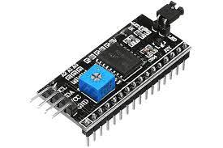
I2C DISPLAY MODULE :
The I2C display module requires a power supply, typically 5V or 3.3V, to operate. It communicates with the microcontroller using the I2C protocol, which uses SDA and SCL for data transmission and clock synchronization. The module needs to be initialized, configuring settings, and addressing its unique I2C address. The microcontroller sends commands and data to display characters, strings, and control display settings. The display module interprets these commands and updates the display accordingly. The module also controls the LED backlight, adjusting brightness and color. Regular refreshes are required to maintain the displayed information.

Slide 11
WORKING:
Step 1: Start
Step 2: When the system is powered up, display the initial data.
Step 3: Scanning of the RFID membership card.
Step 4: If the membership card scan is successful fetch all the personal details & display it on the LCD. If not, scan the membership card once again. Loop repeats until the scanning process is successful.
Step 5: Now the product scanning process is ready. If the scanned product code is detected, display all the product details on the LCD screen. If not, the product has to be scanned until it gets detected. This process applies to each & every product.
Step 6: If a scanned product is scanned once again then that product is removed from the microcontrollers memory & in the ongoing bill.
Step 7: Finally, to end the shopping, the shopper has to scan the Membership card. If the card is successfully scanned, then the complete bill summary is displayed on the LCD.
Step 8:At the Exit there will be counter the Customer needs to Pay the amount there.
Step 9: Stop.

Slide 12
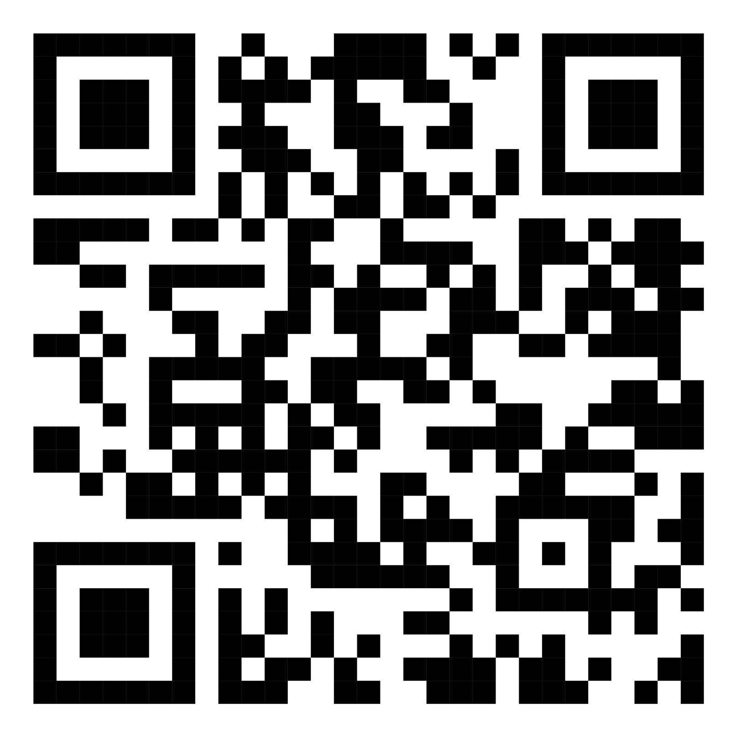
THE BLUEPRINT OF THE SHOP
By scanning this QR code we will get an blueprint of the shop so that we can go directly to place what we need and buy.
By adding this QR to shop customer will be getting benefited by buying what they required rather than buying what they don’t want.

Slide 13
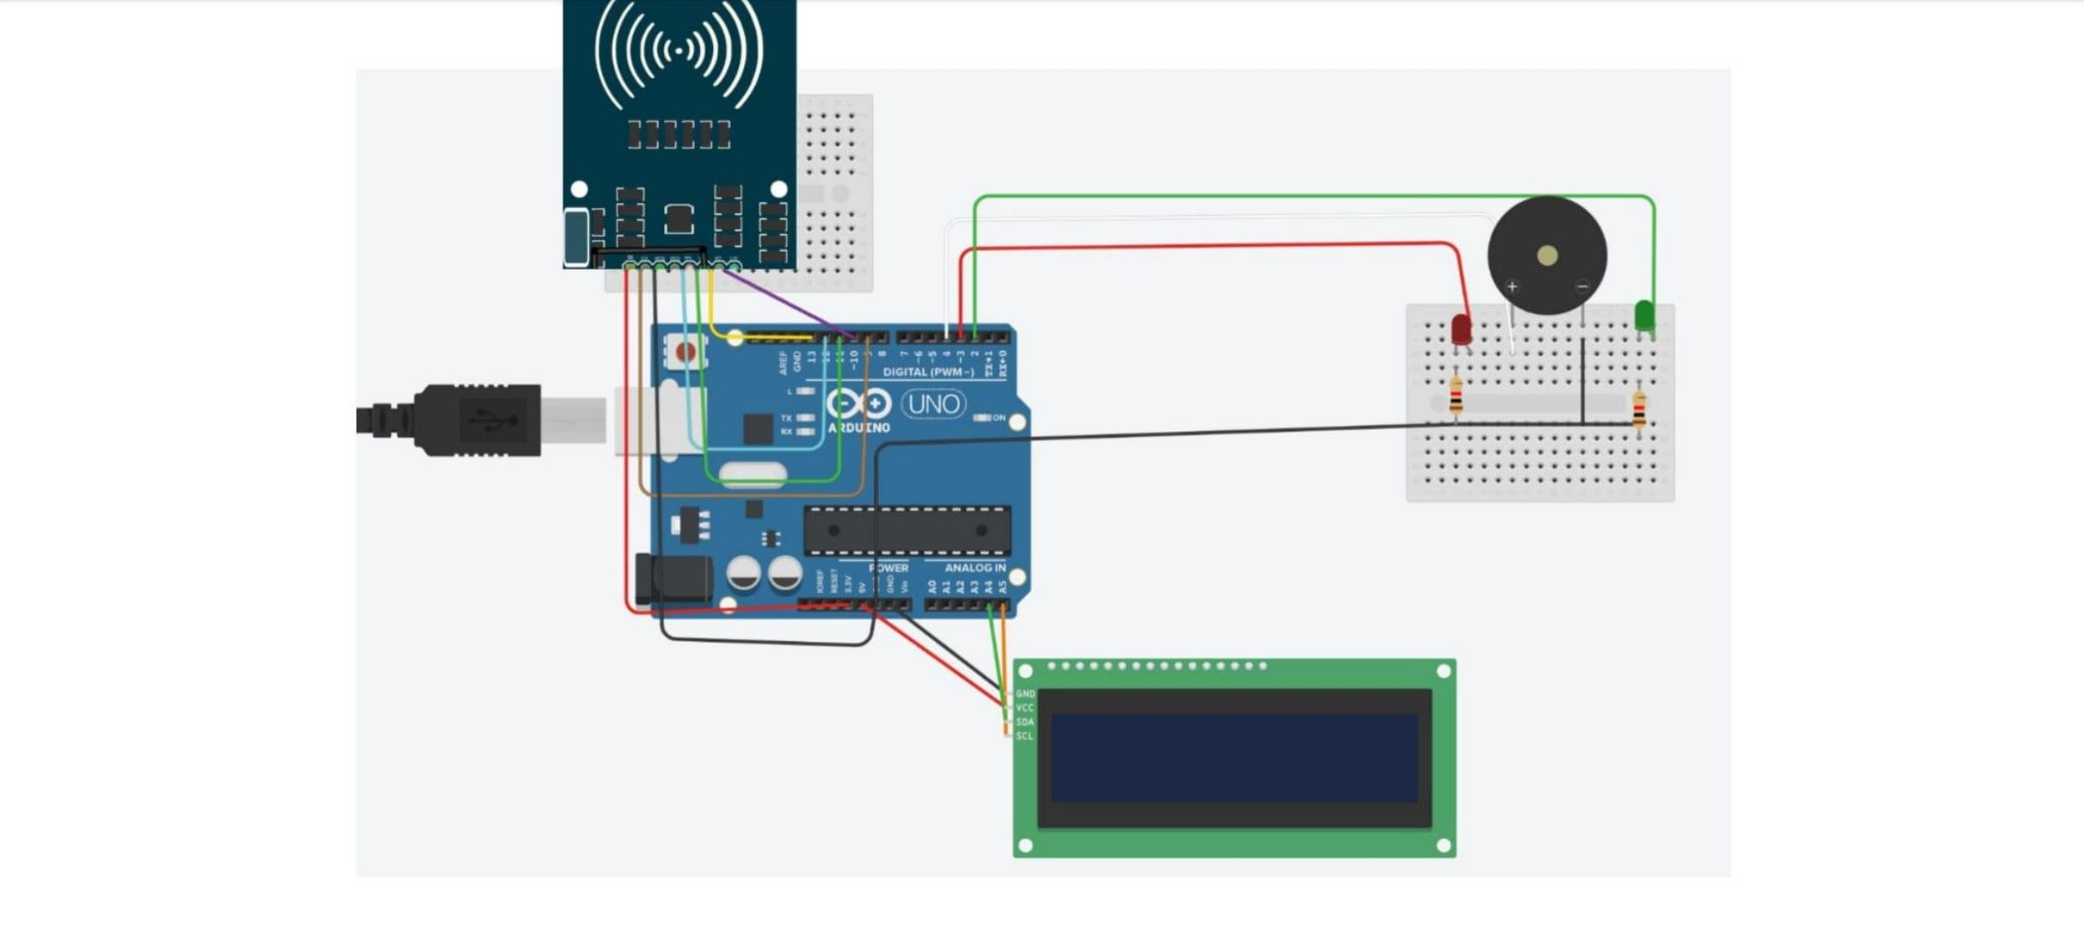
CIRCUIT DIAGRAM

Slide 14
RESULT
Text displaying once the system is powered up and initialized.Once the system is powered up & initialized a text is displayed saying Automated Shopping trolley. This means the system is ready for scanning products. Now the shopper has to scan the membership card.
Item details being displayed if the scanning is successful.Now after the membership card is scanned successfully the system is ready to scan products. When a product is scanned all its details will be fetched by MC & displayed on the LCD screen including name, quantity, price as well as the manufacturing & expiry dates.Final bill summary being displayed
When the shopping is completed if the shopper scans the membership card, shopping ends & all the bill details will be shown on the LCD screen. It displays the final bill amount: the amount balance which was present before shopping & balance amount remaining after the shopping bill is paid

Slide 15
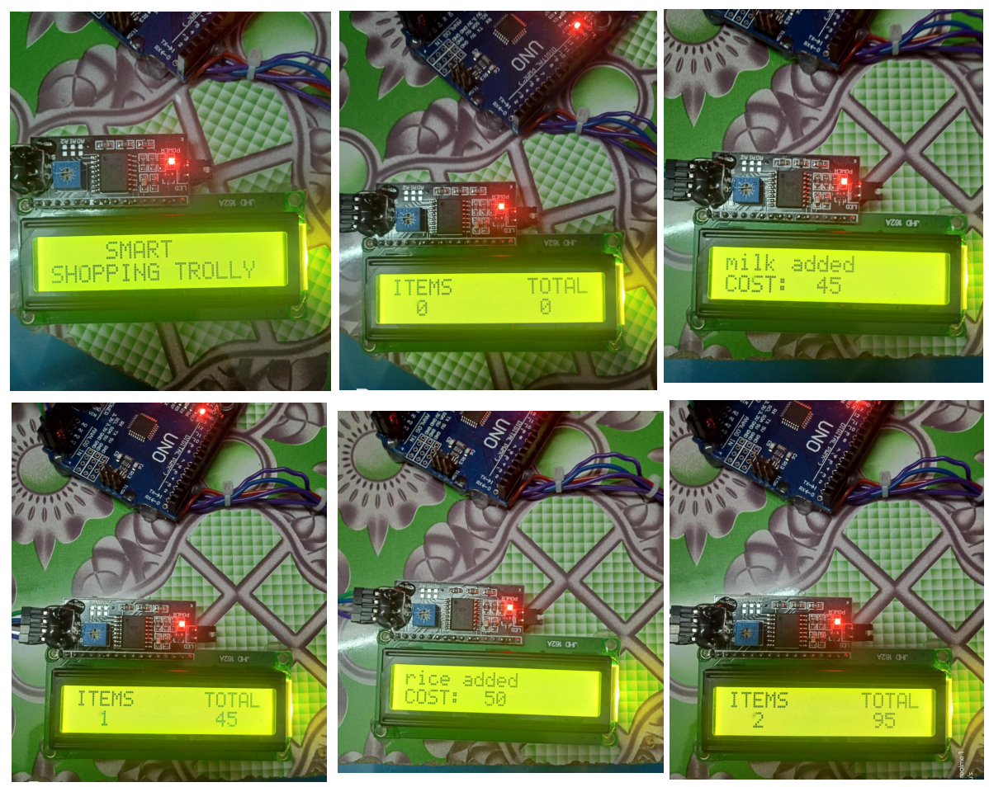

Slide 16
CONCLUSION
The Work done with the help of Rfid technology, MFRC 522 reader and Arduino. It’s aim is to reduce the time of billing in long queues so that the customers gets benefited and the same time inventory management becomes so easy. It can be implemented in shopping malls where there is a large crowd and huge rush into malls. In the world of Automation, This automatic billing system plays a major role in the upliftment of technology. This technology will replace the present barcode system which is present being followed. Hence this technology can help people to make their life’s easy and time saving too.

